Slide 1
Before that step git in pc ref: Create locally remote repo like tfs collection.docx
View git like tfs in web

Slide 2
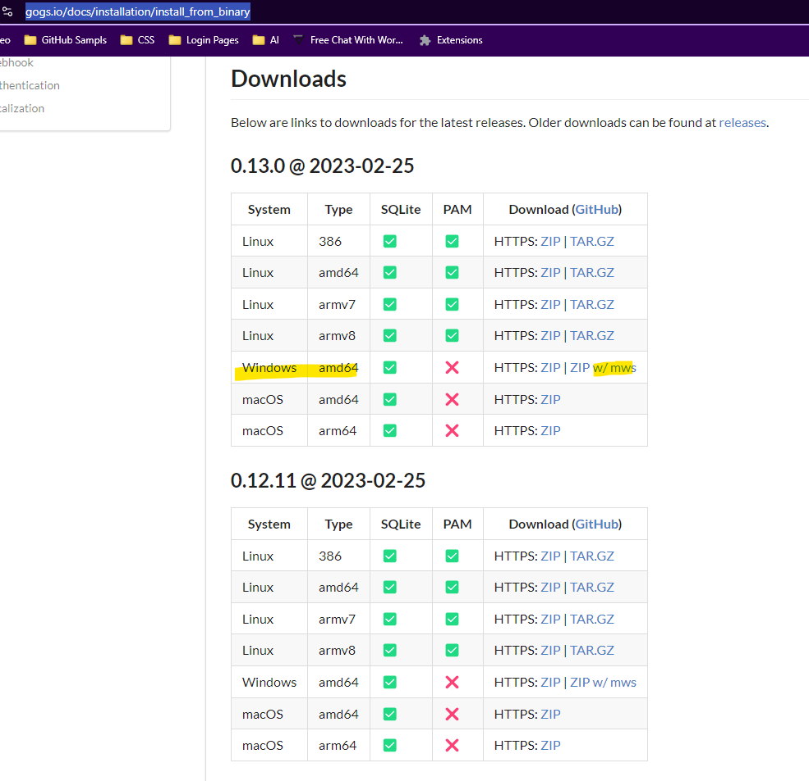
https://gogs.io/docs/installation/install_from_binary

Slide 3
Using Gogs on Windows
Gogs is a lightweight and easy-to-set-up Git service. Here’s how to get it running on Windows: Download Gogs:
Extract the Archive:
Run Gogs:
Open a command prompt and navigate to the directory where you extracted Gogs:
cd C:\Gogs
gogs web
Access Gogs:
Open your web browser and navigate to http://localhost:3000. You’ll see the Gogs setup page.
Complete Setup:
Follow the on-screen instructions to configure Gogs, including setting the path for repositories and admin account settings.

Slide 4
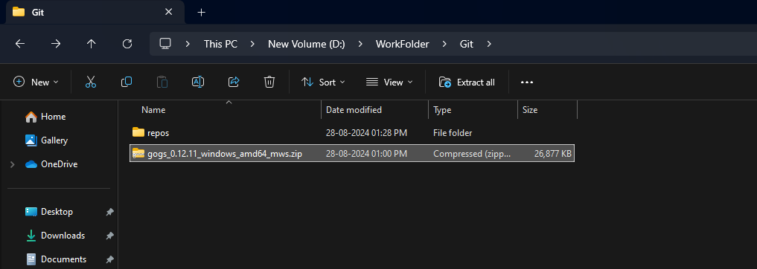
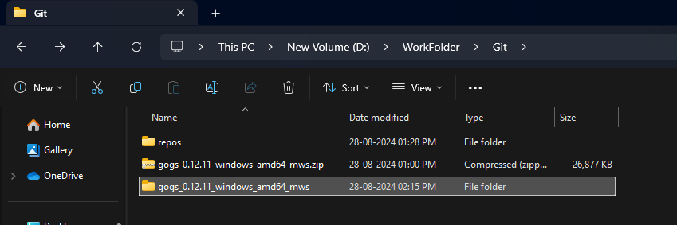

Slide 5
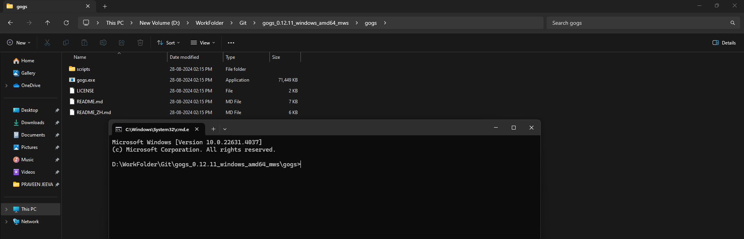

Slide 6
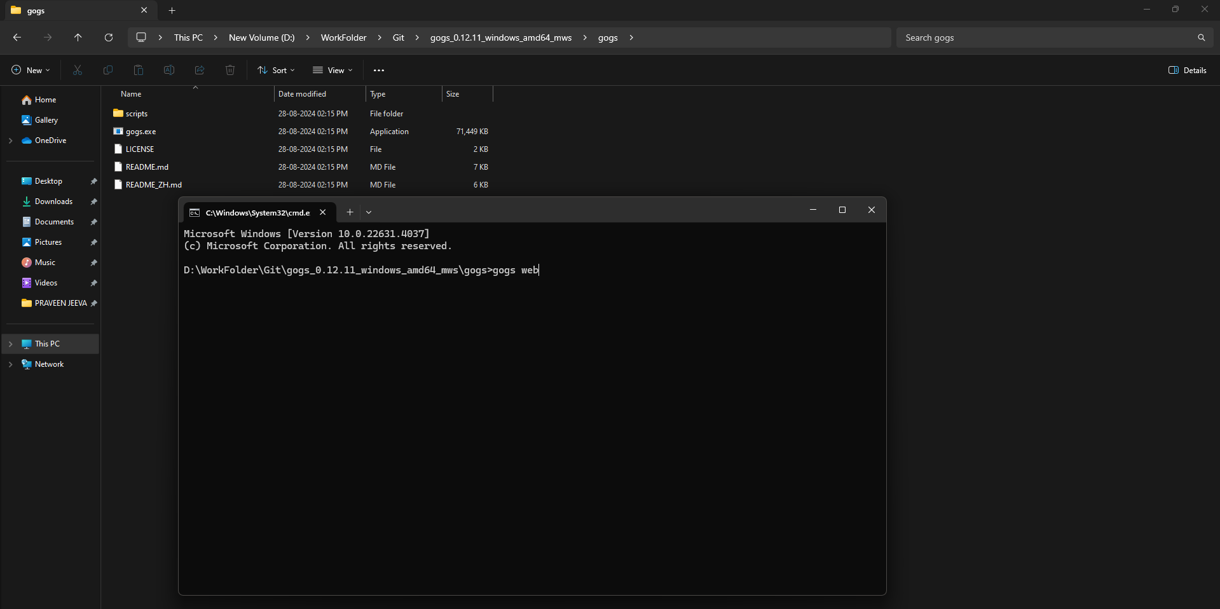

Slide 7
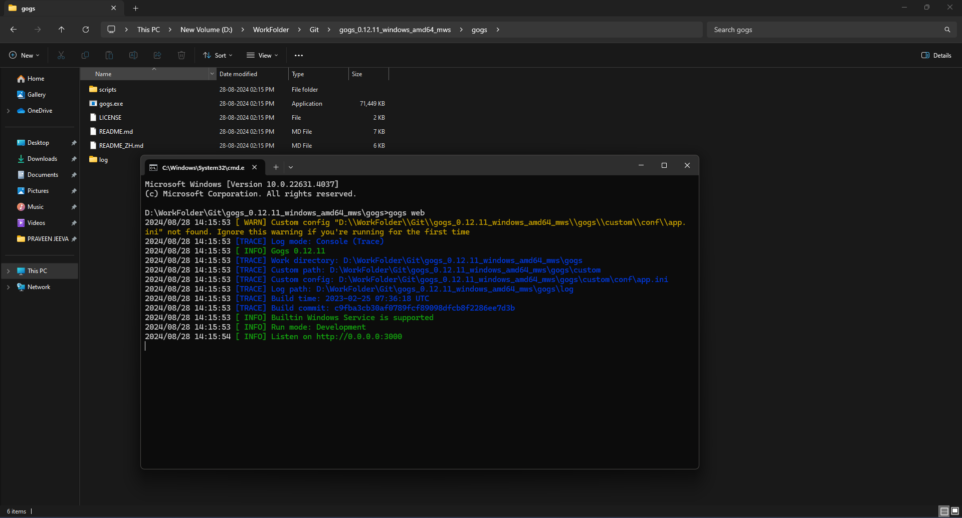

Slide 8
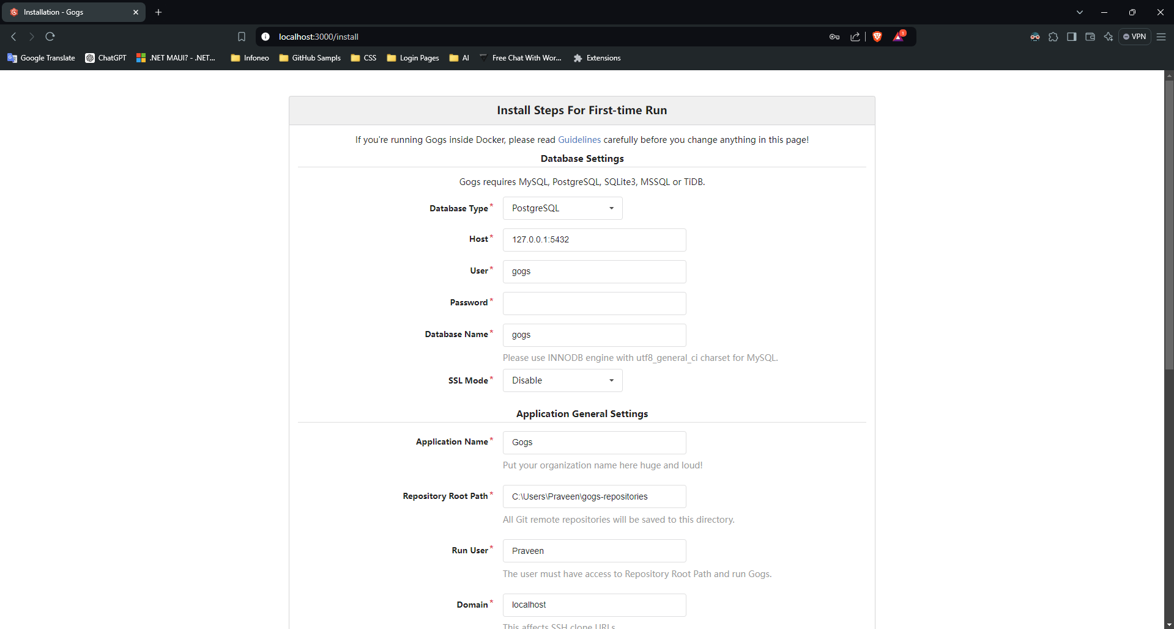

Slide 9
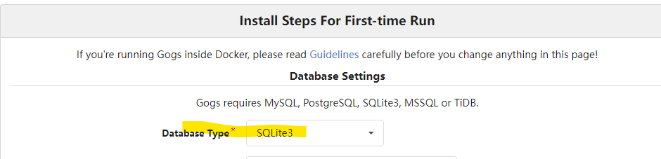

Slide 10
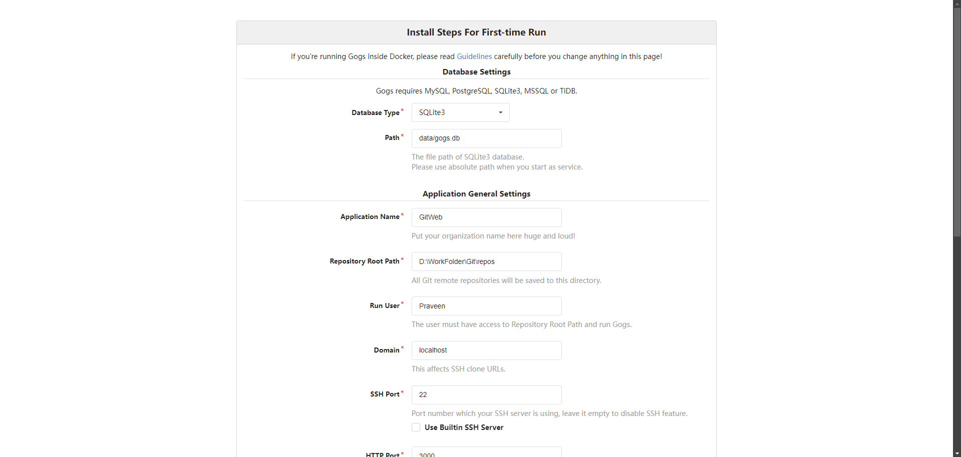

Slide 11
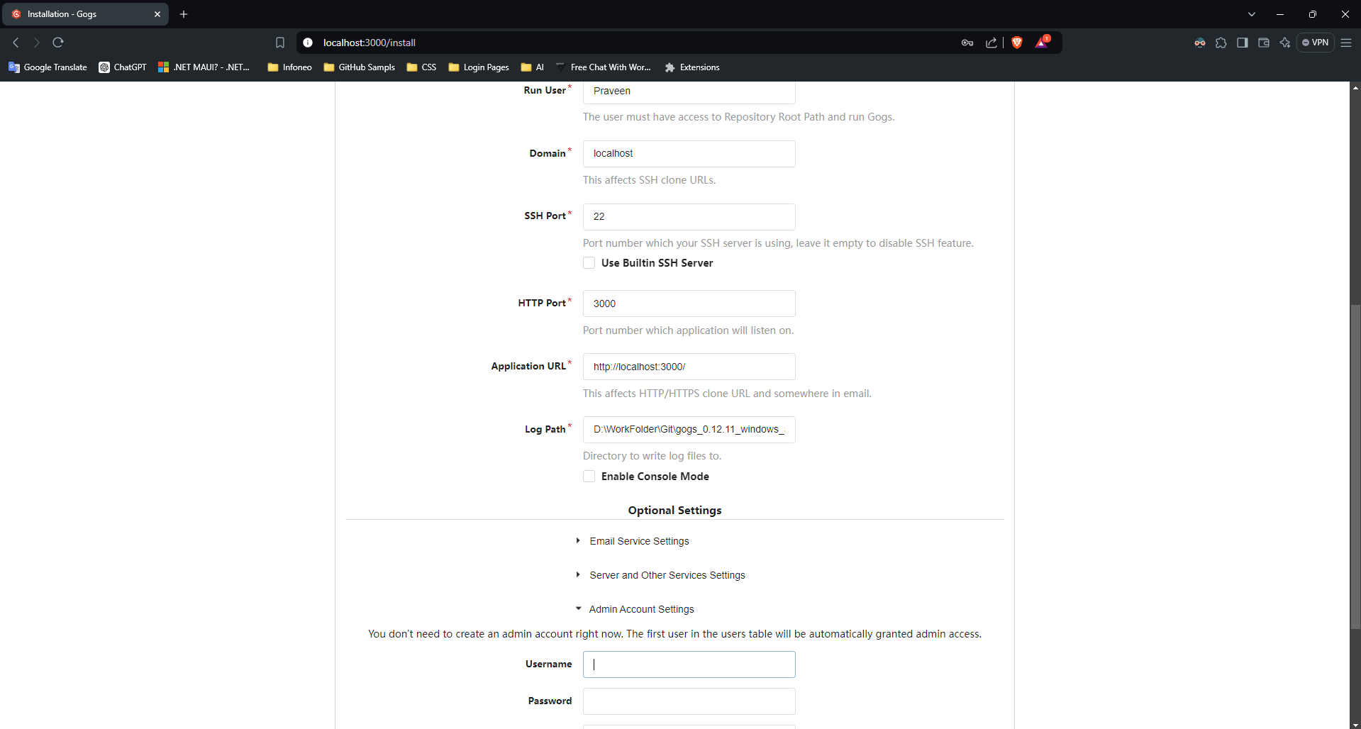

Slide 12
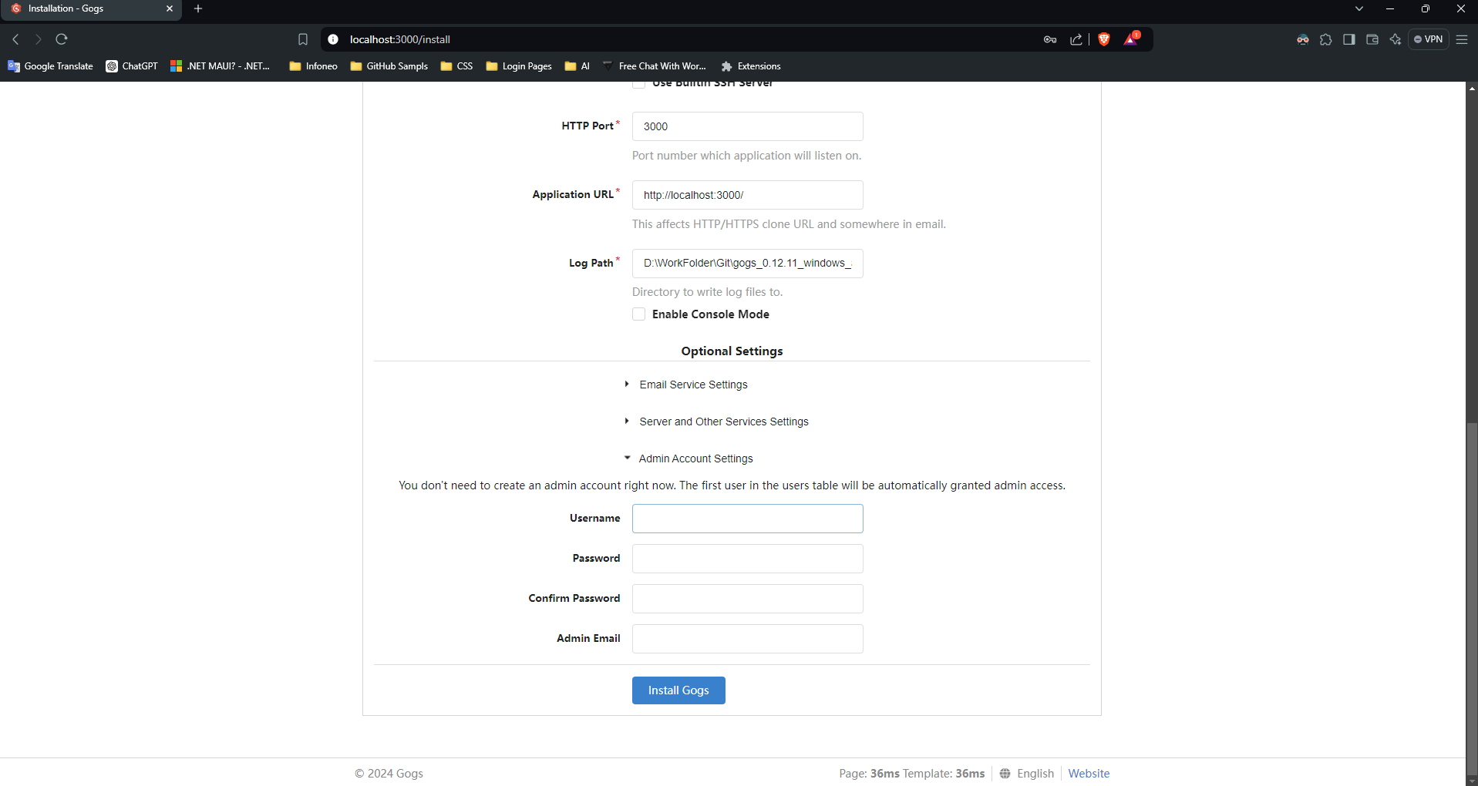

Slide 13
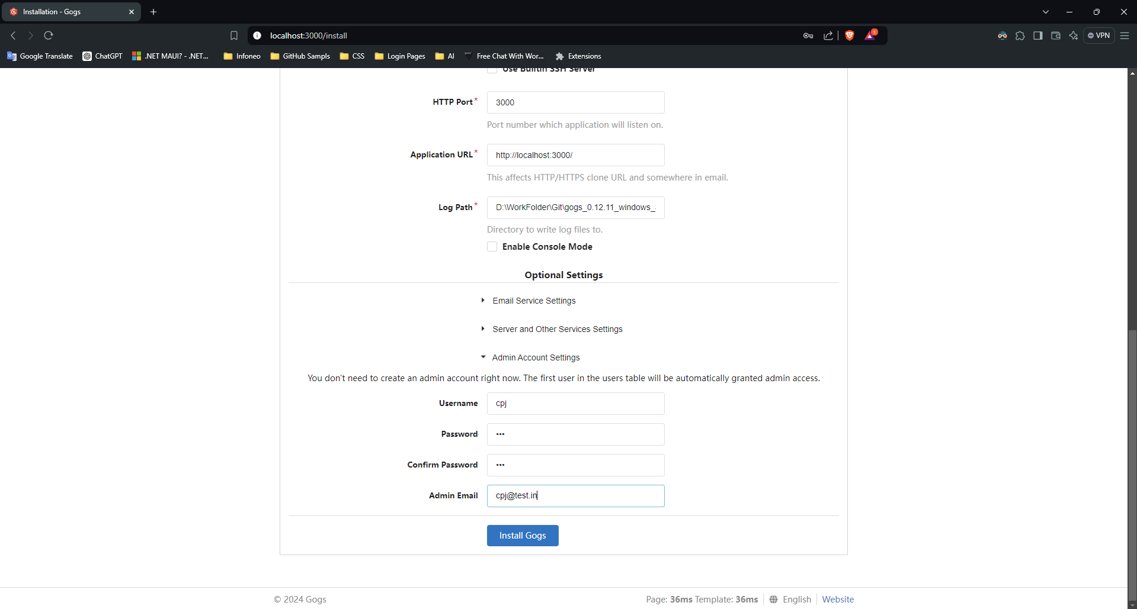

Slide 14
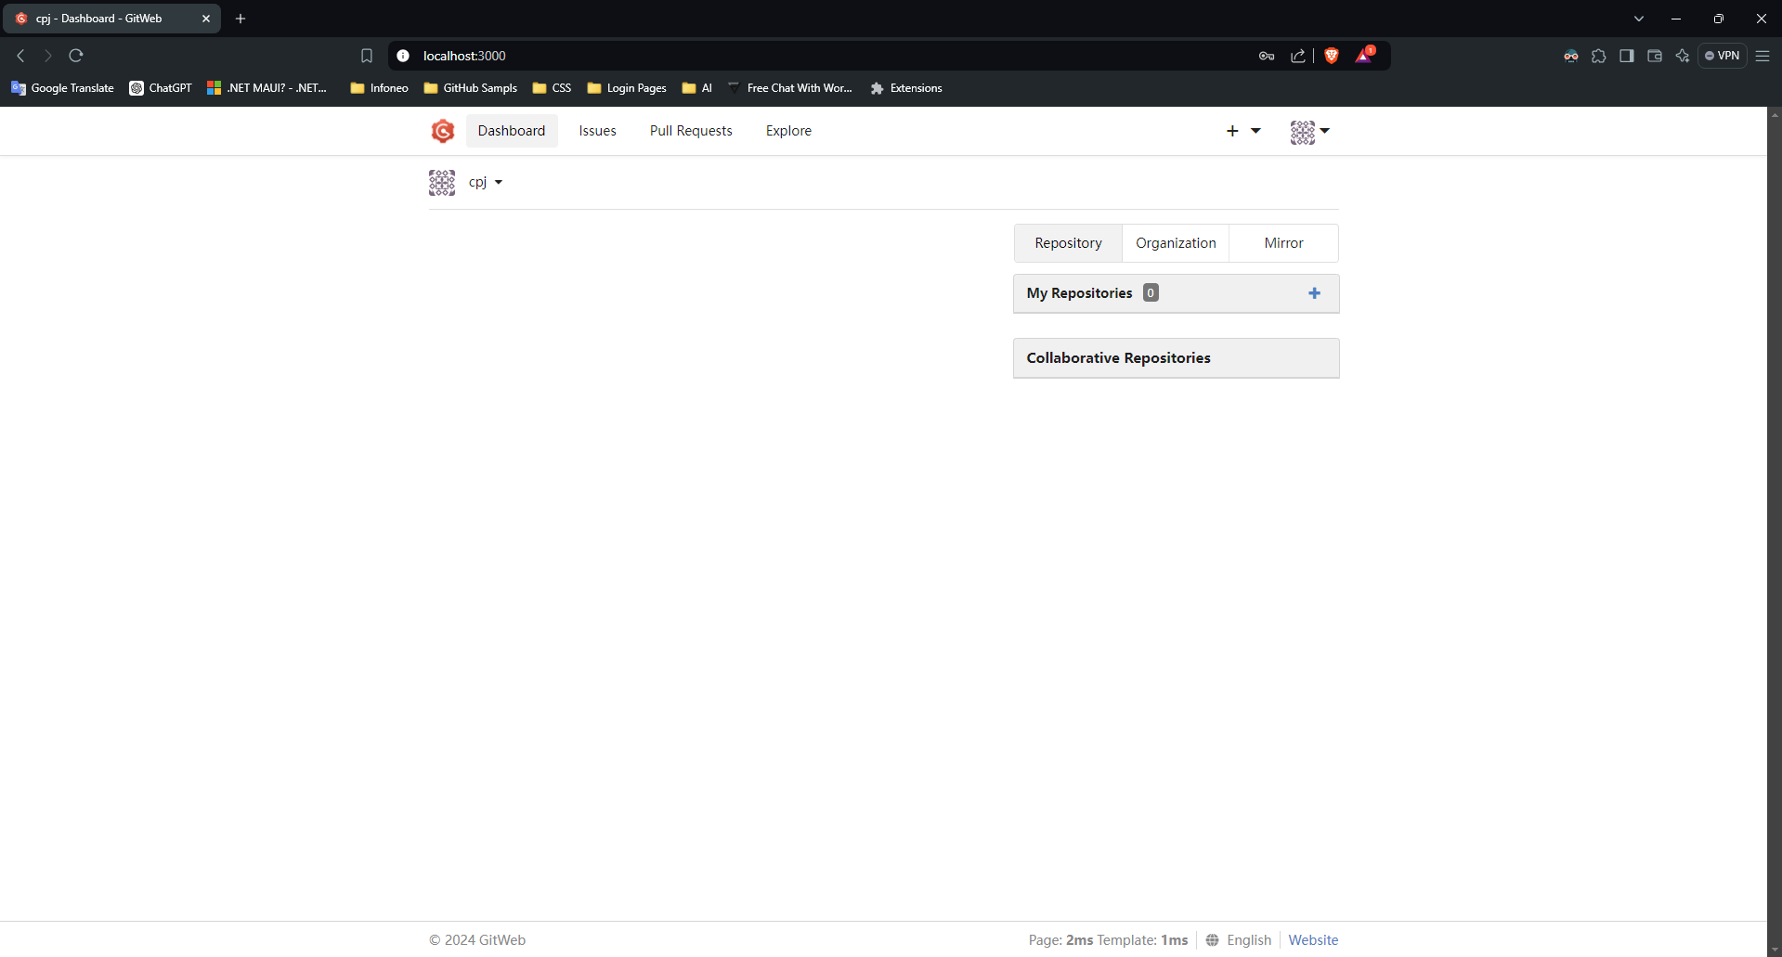

Slide 15
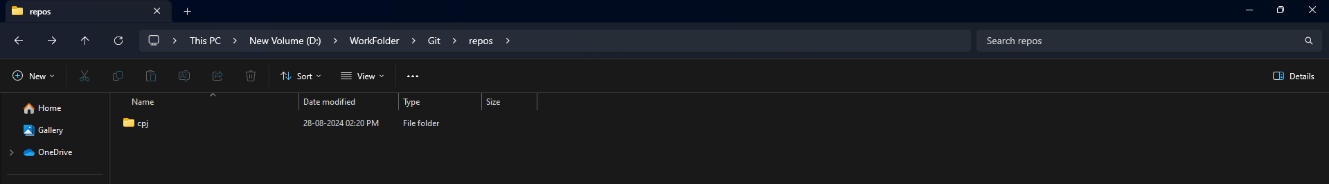
One folder created on users name

Slide 16
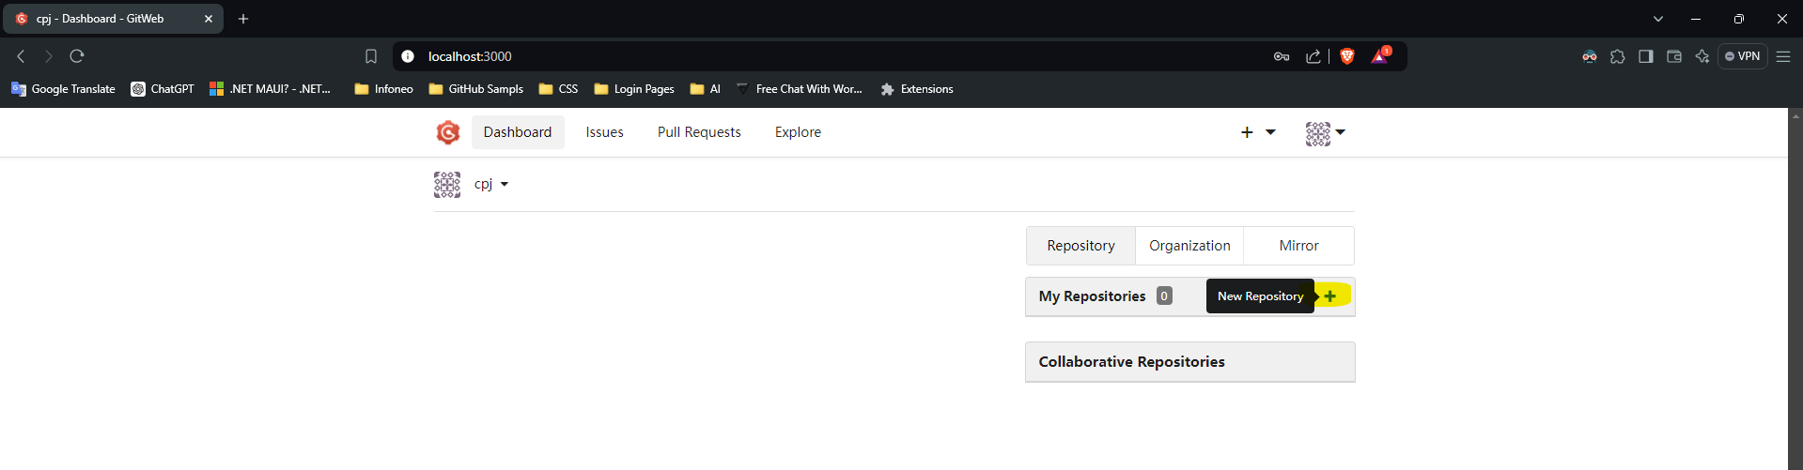

Slide 17
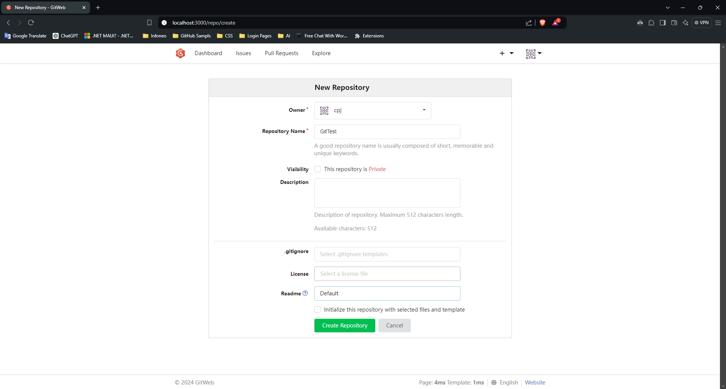

Slide 18
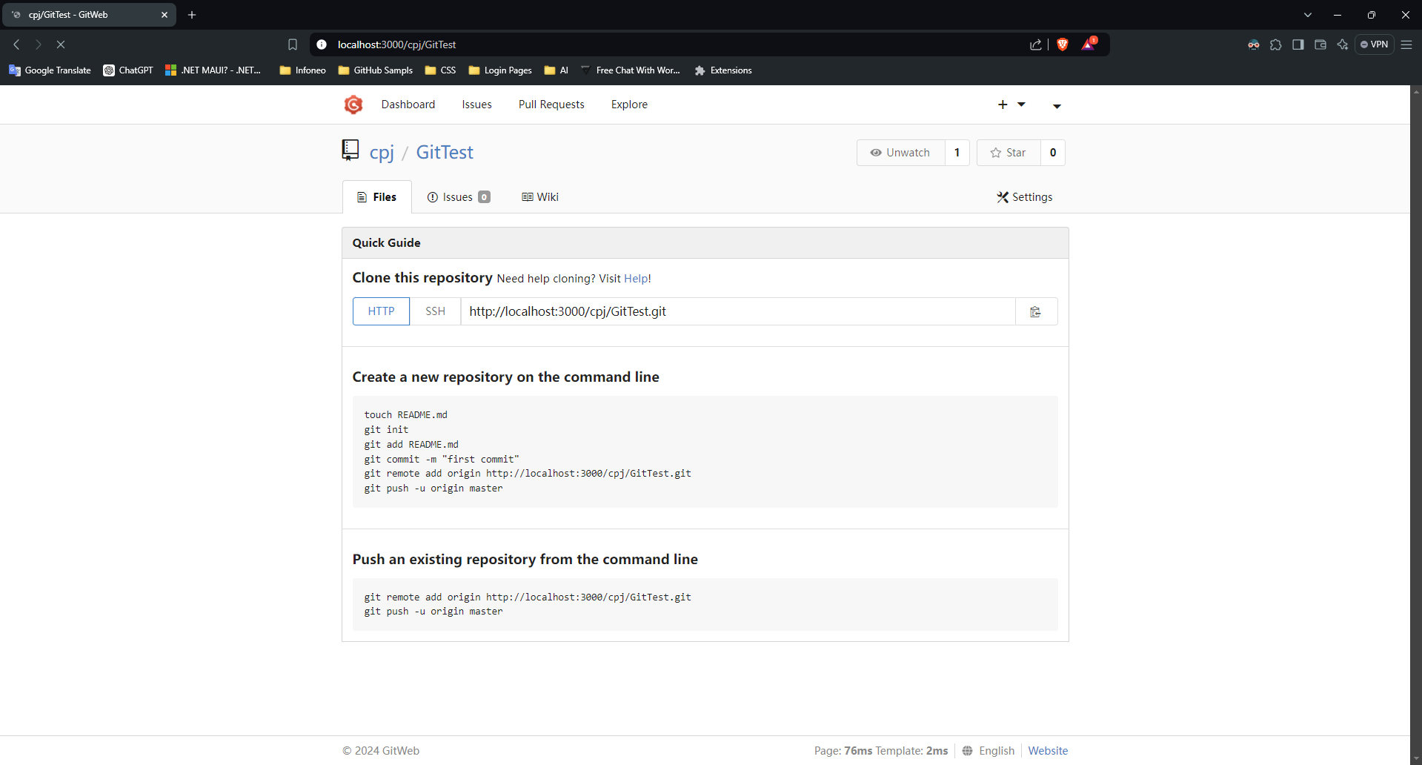

Slide 19
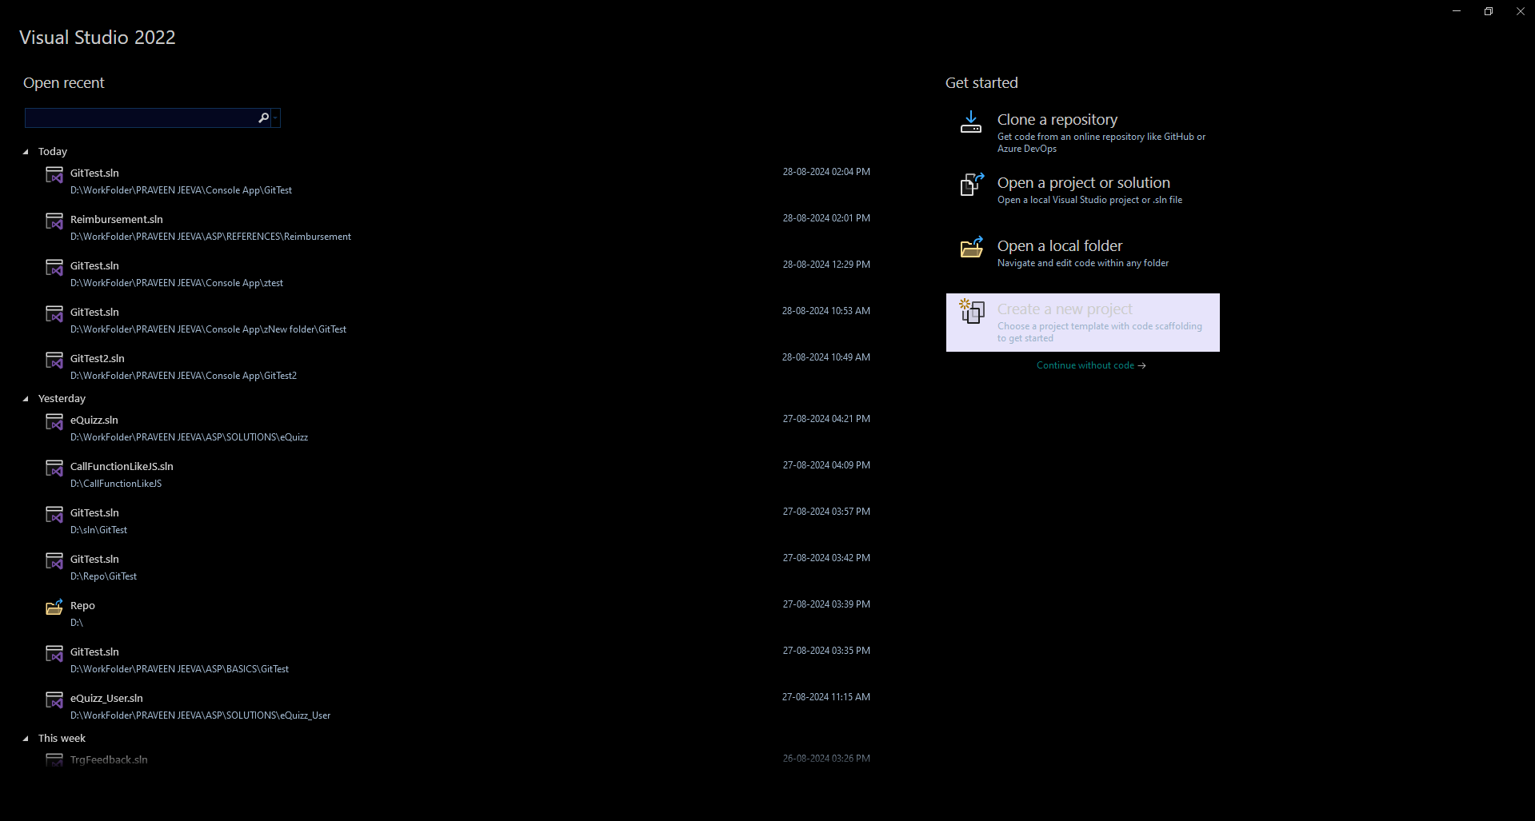

Slide 20
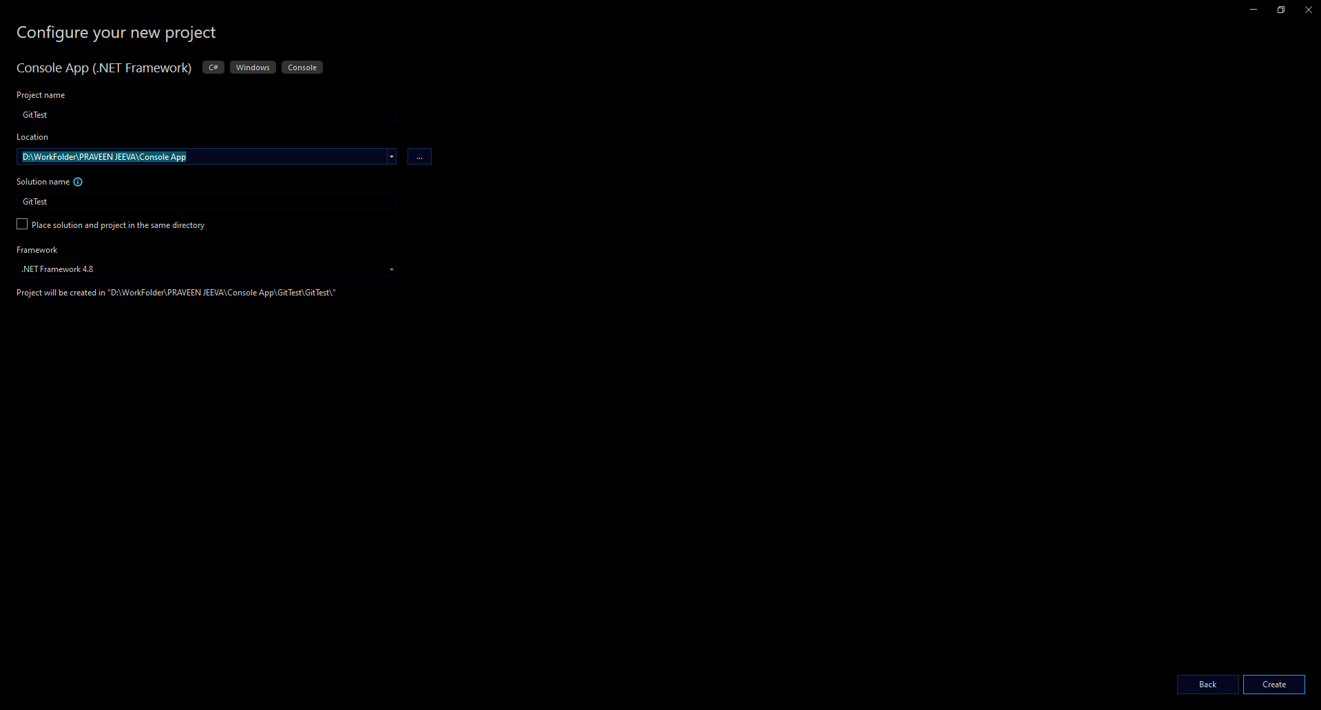

Slide 21
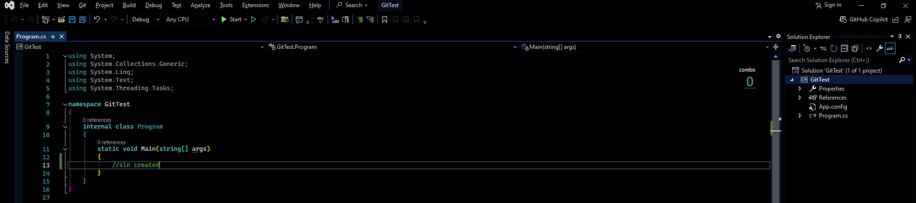
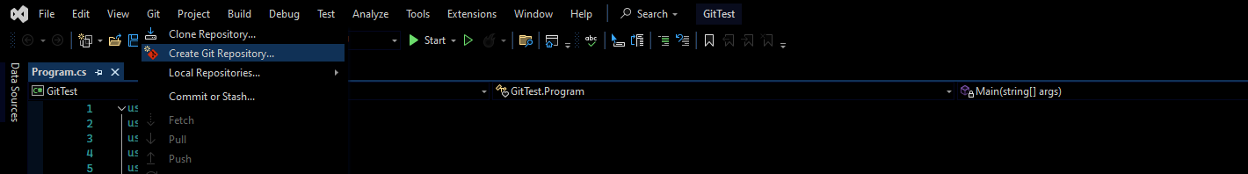

Slide 22
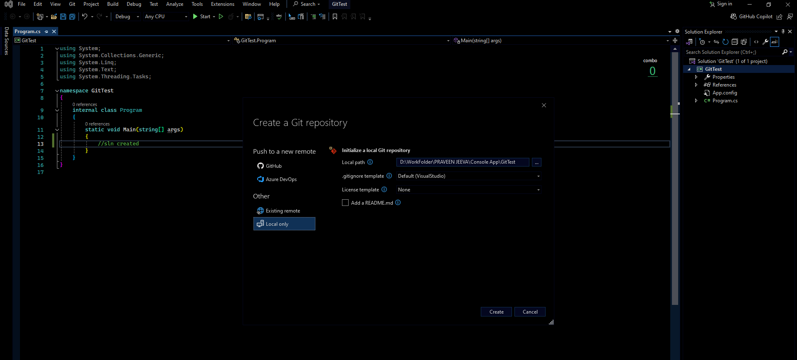

Slide 23
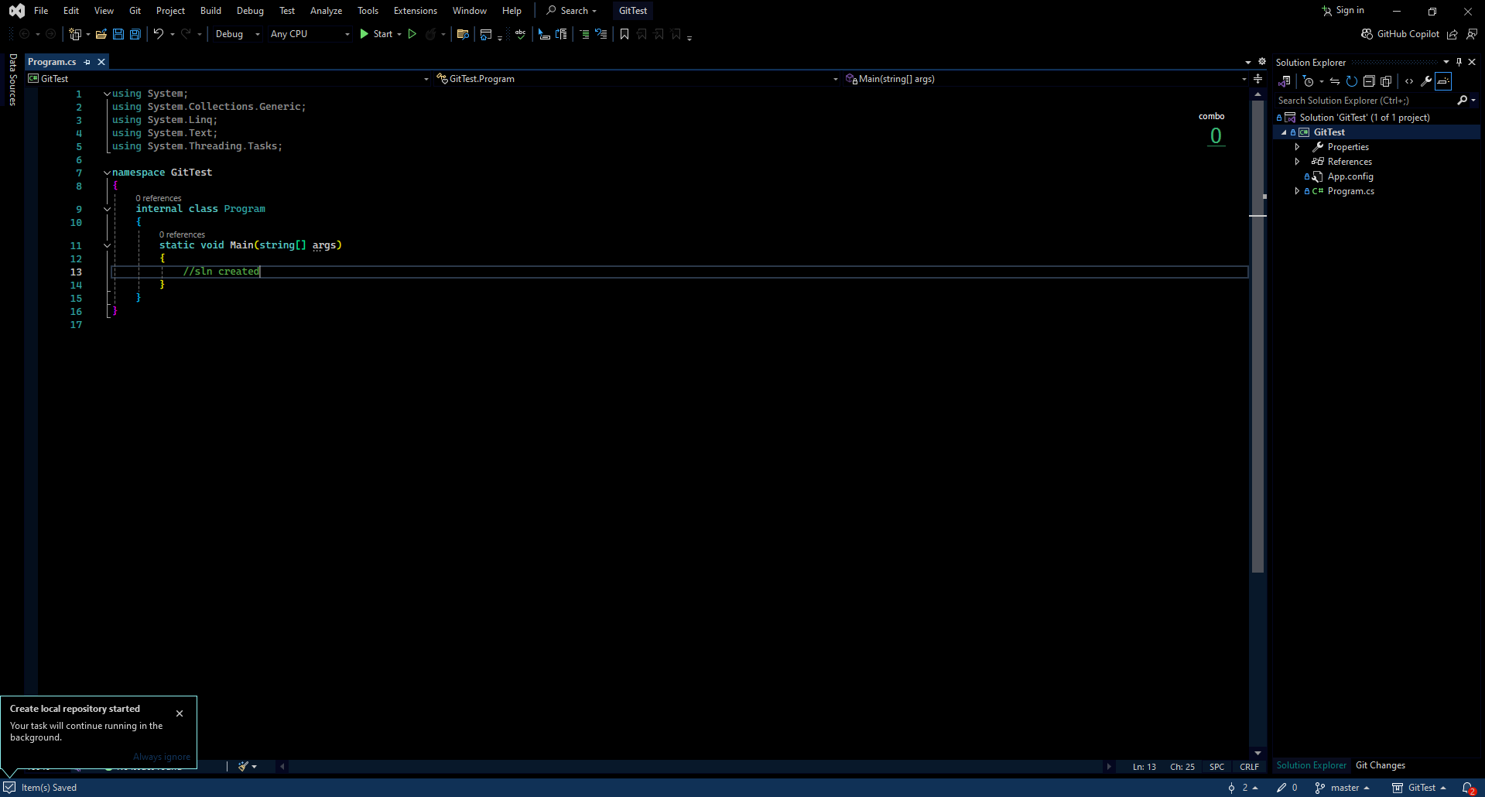

Slide 24
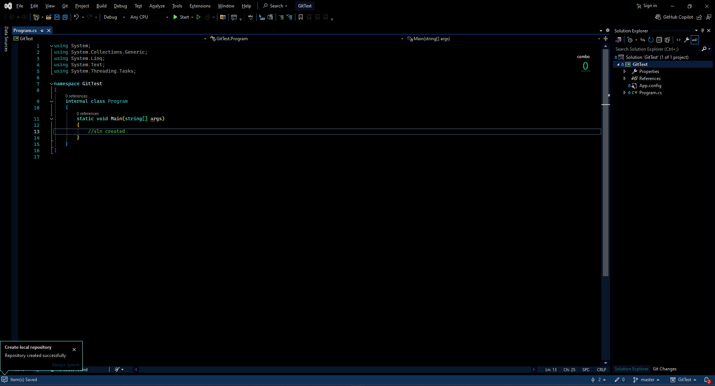

Slide 25
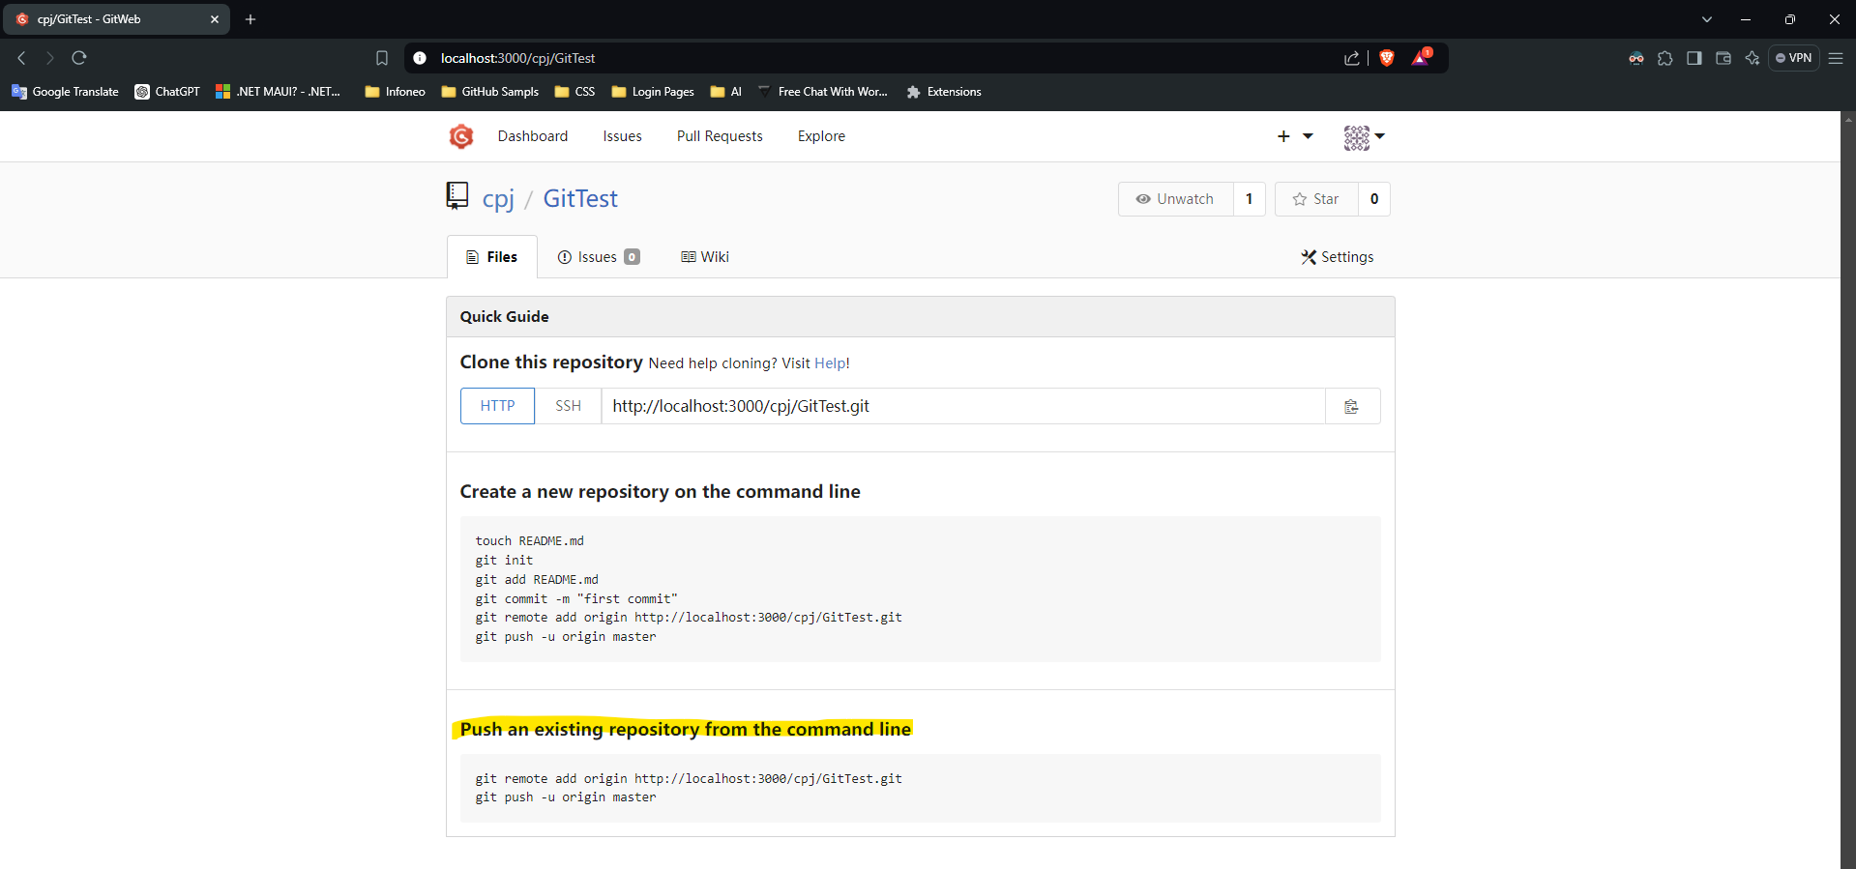

Slide 26
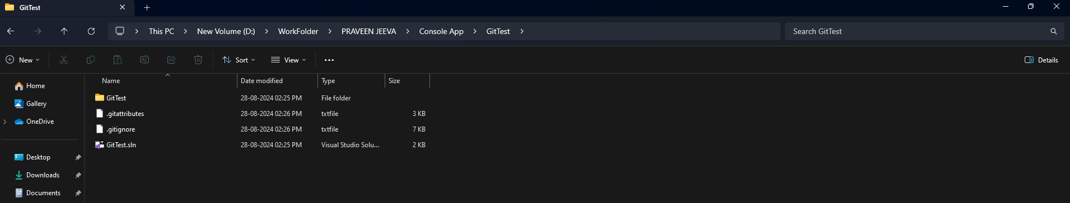
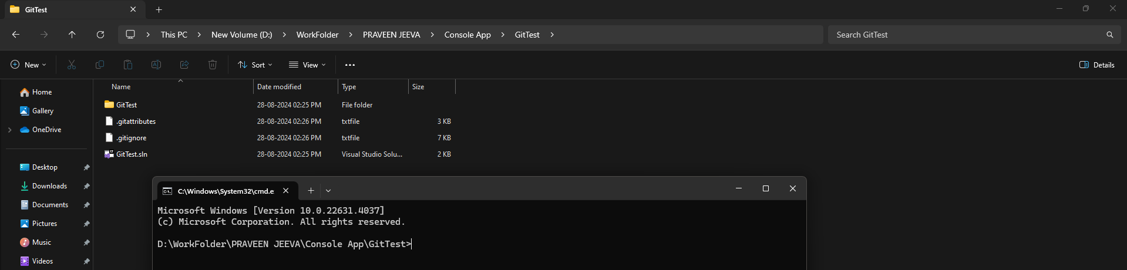

Slide 27
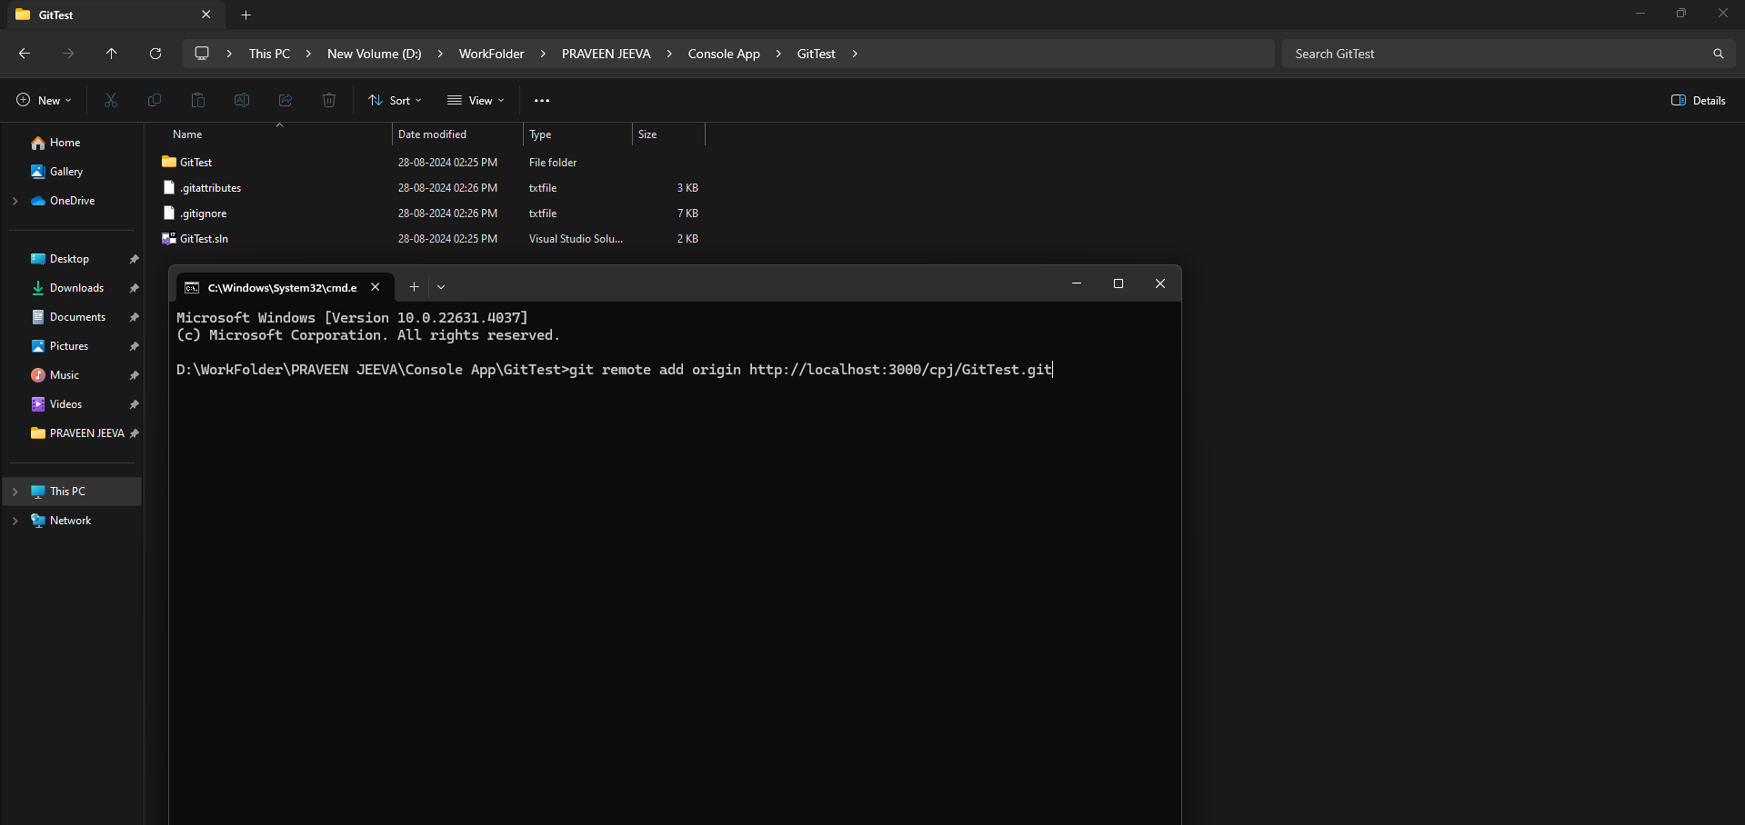

Slide 28
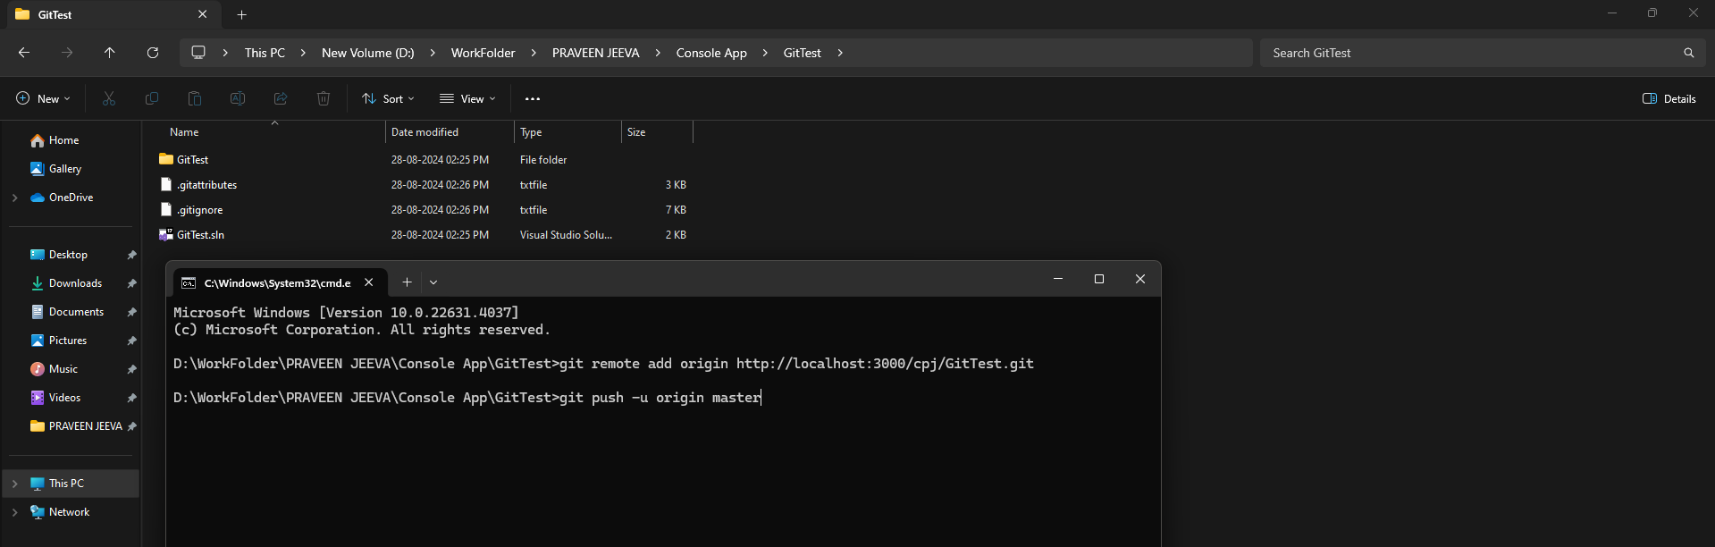

Slide 29
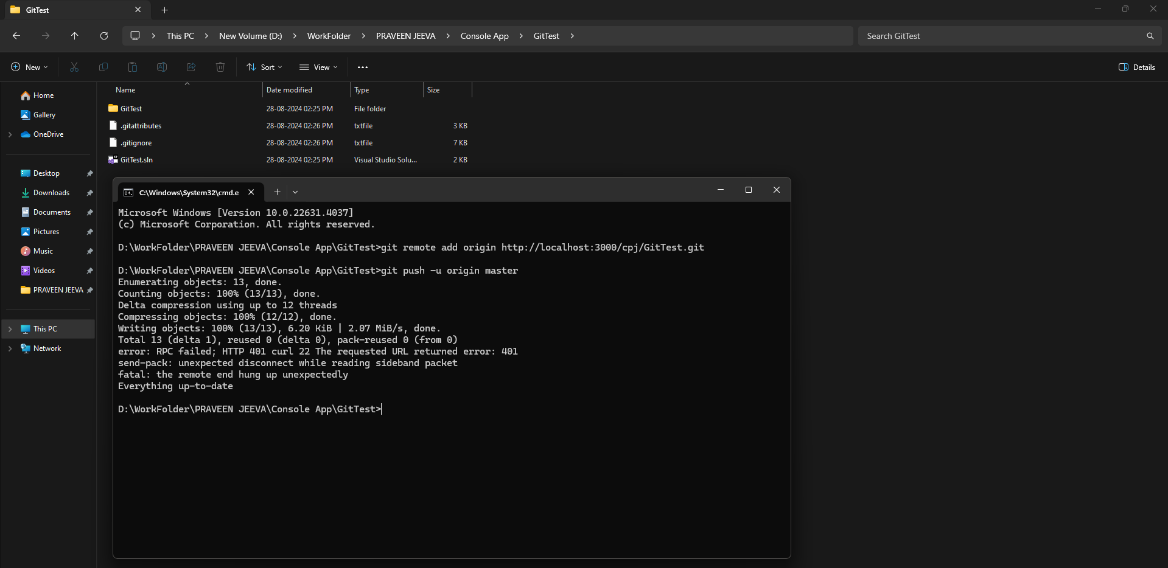

Slide 30
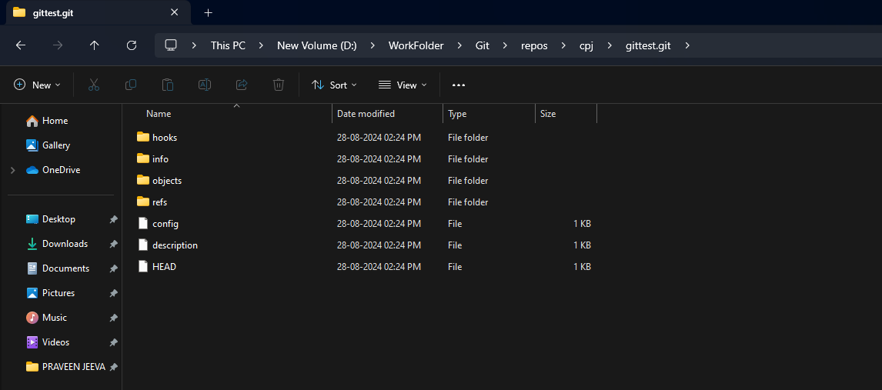
Created repo added

Slide 31
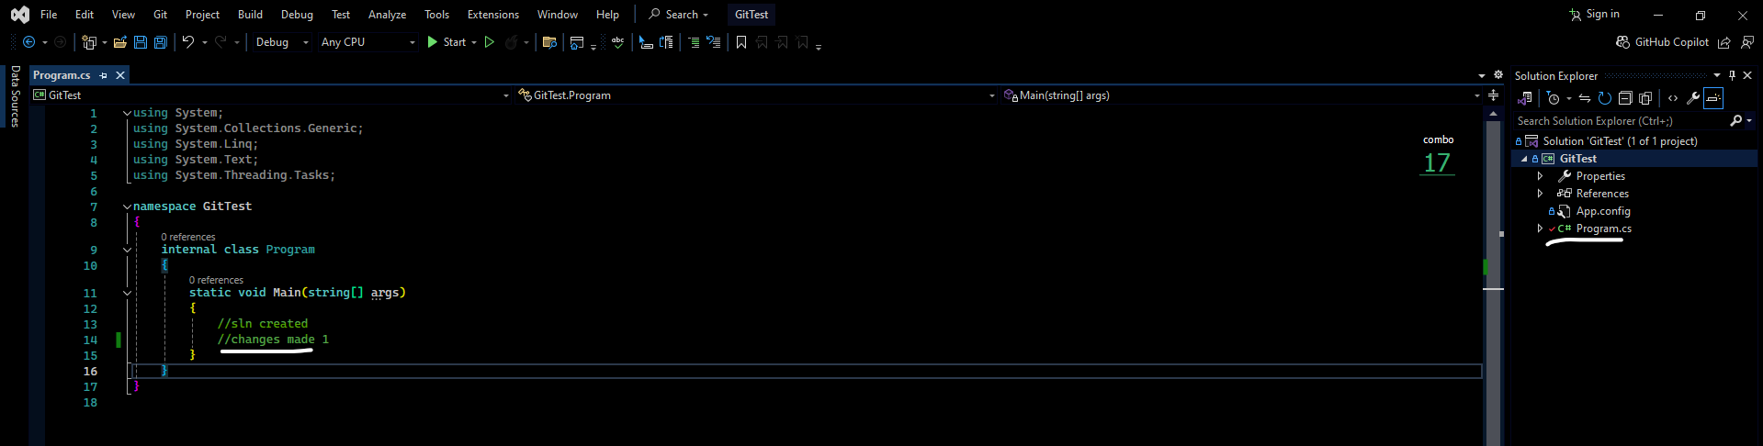
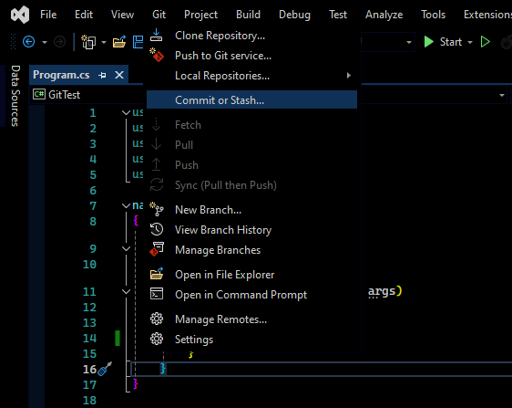
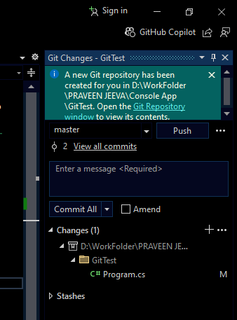

Slide 32
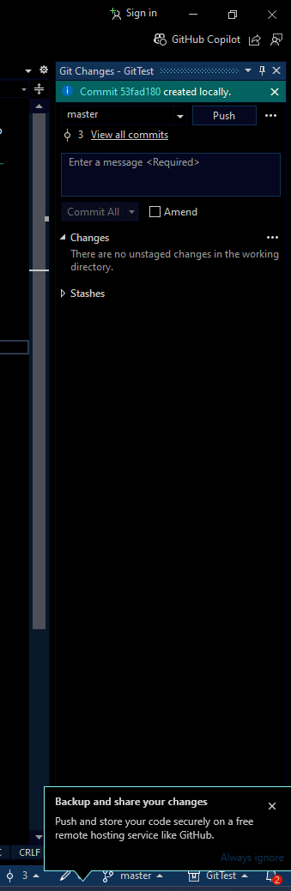
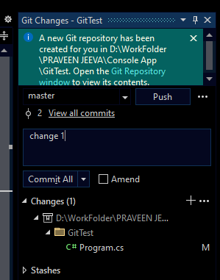
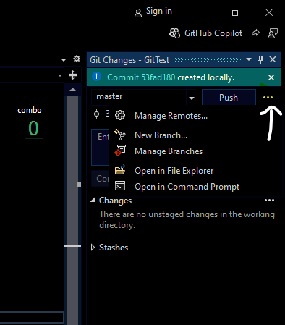

Slide 33
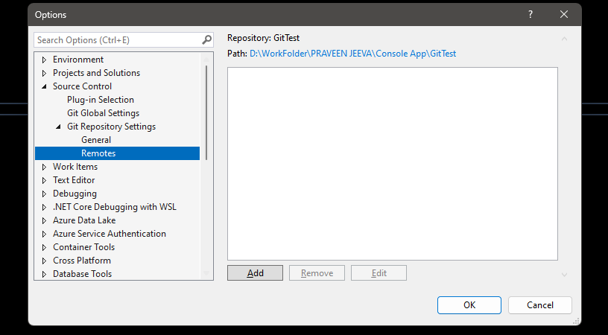
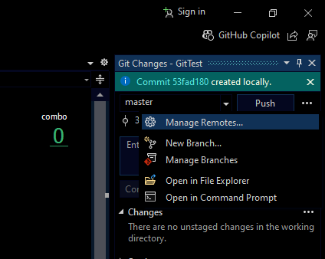

Slide 34
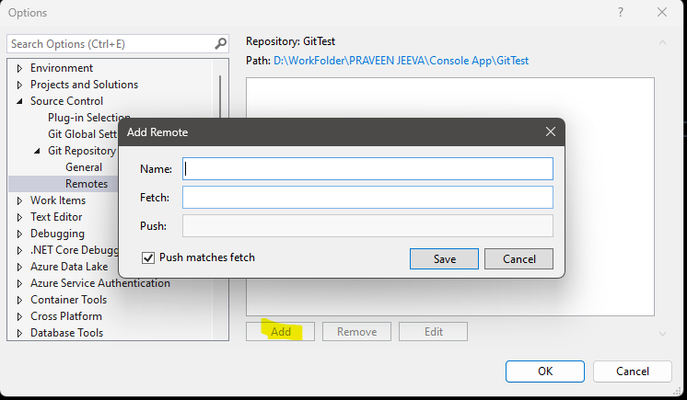

Slide 35
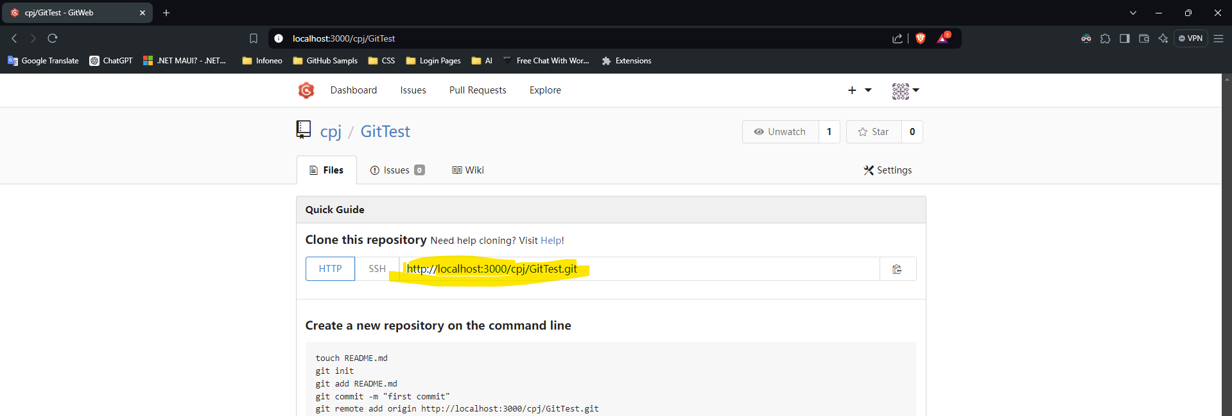

Slide 36
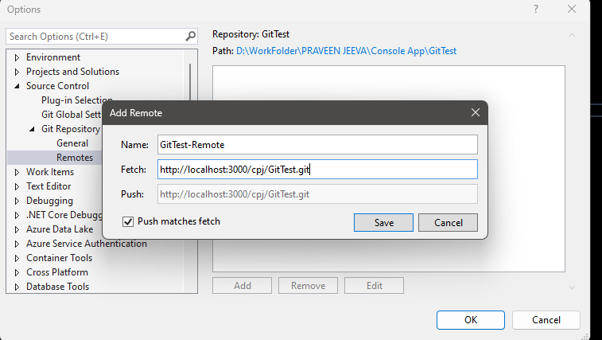

Slide 37
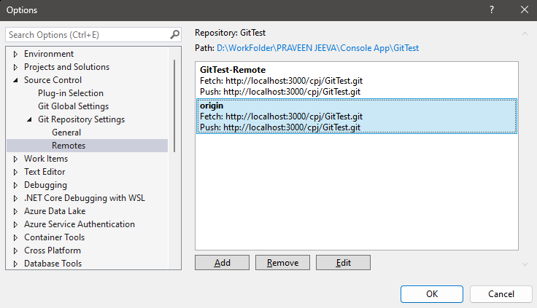

Slide 38
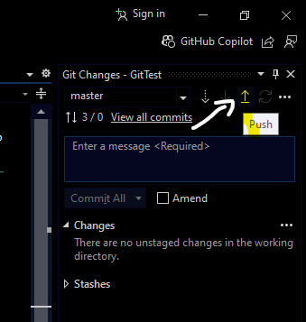
Click push then changes will affect it remote repo which was created early, other changes only there in client pc only. If we push then only other user get latest version via sync like tfs

Slide 39
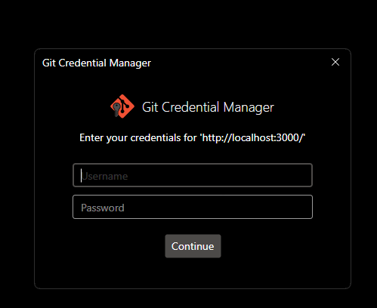
Only for first time

Slide 40
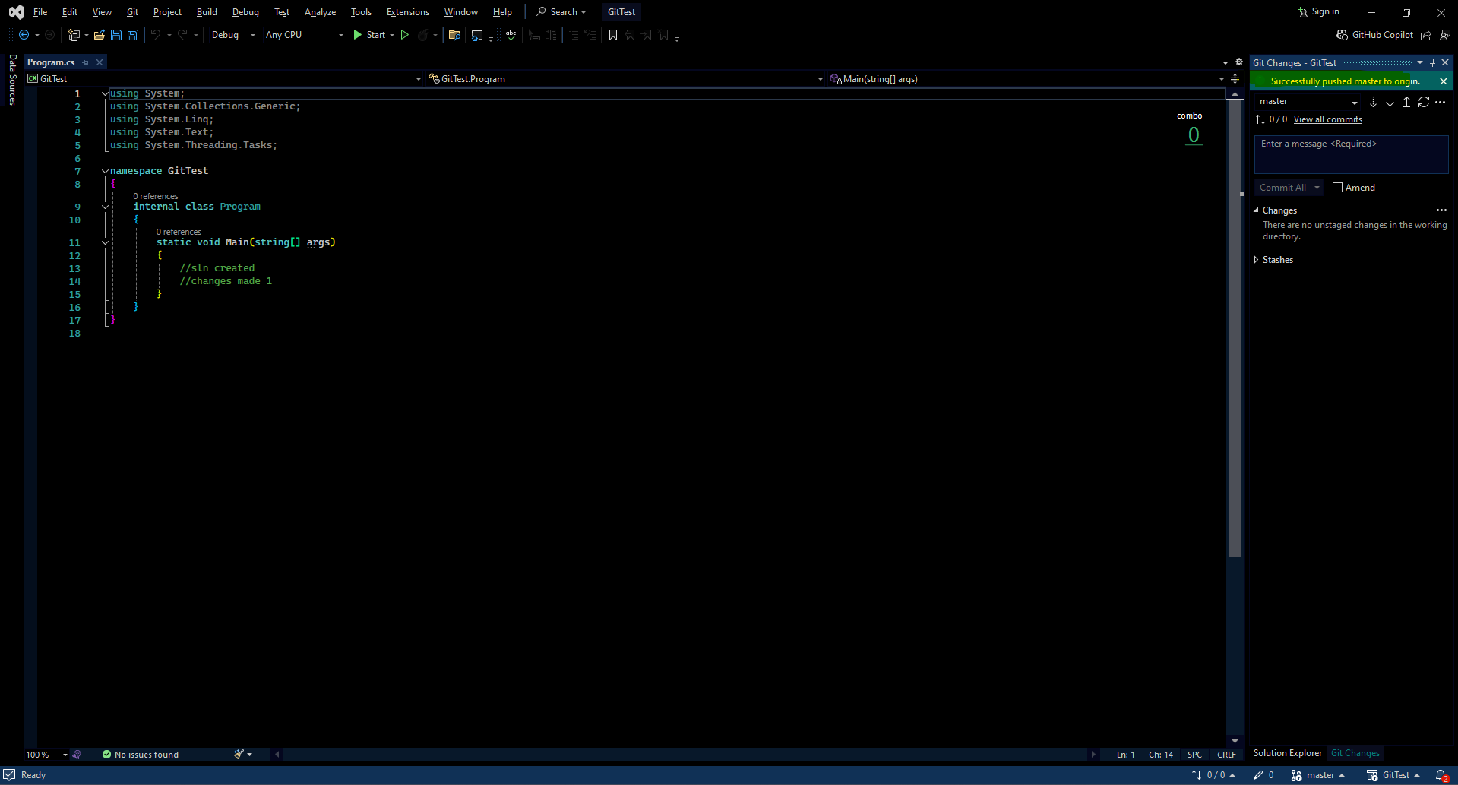

Slide 41
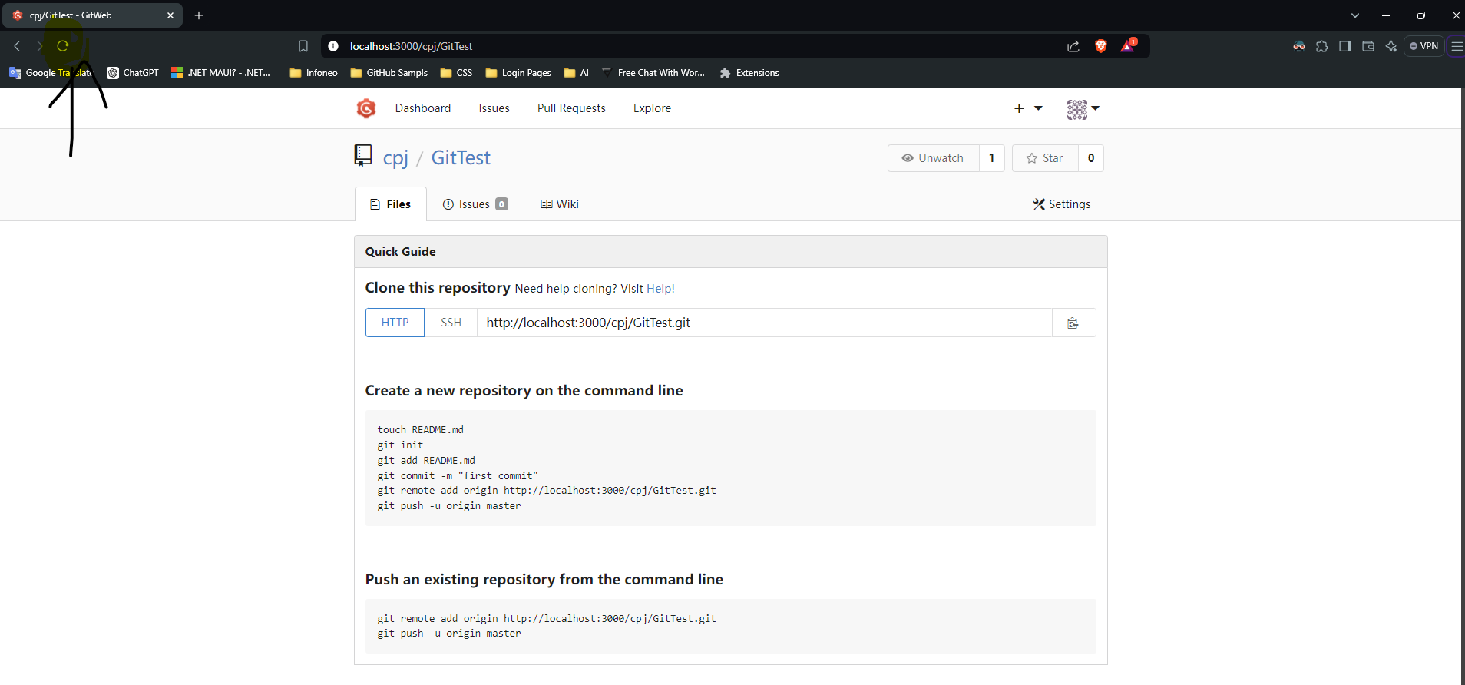

Slide 42
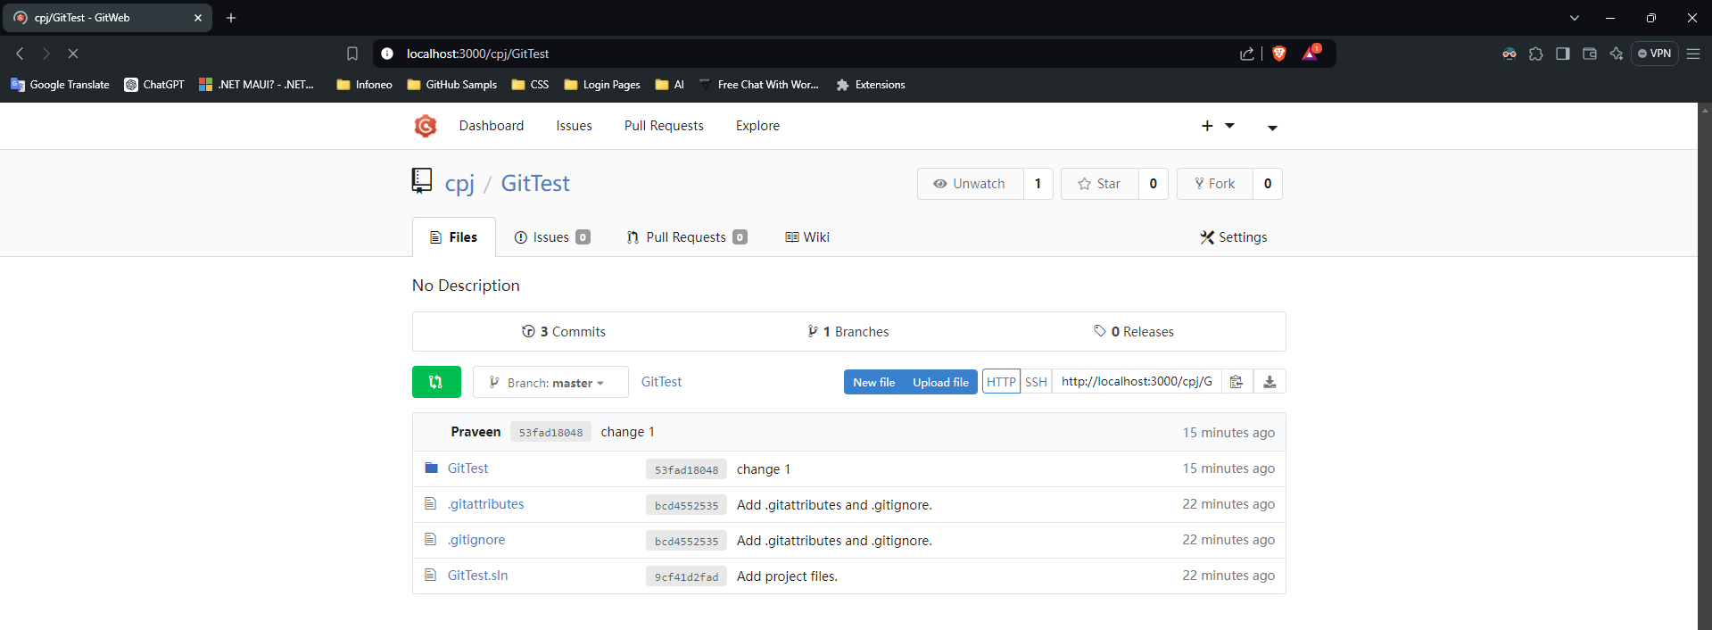

Slide 43
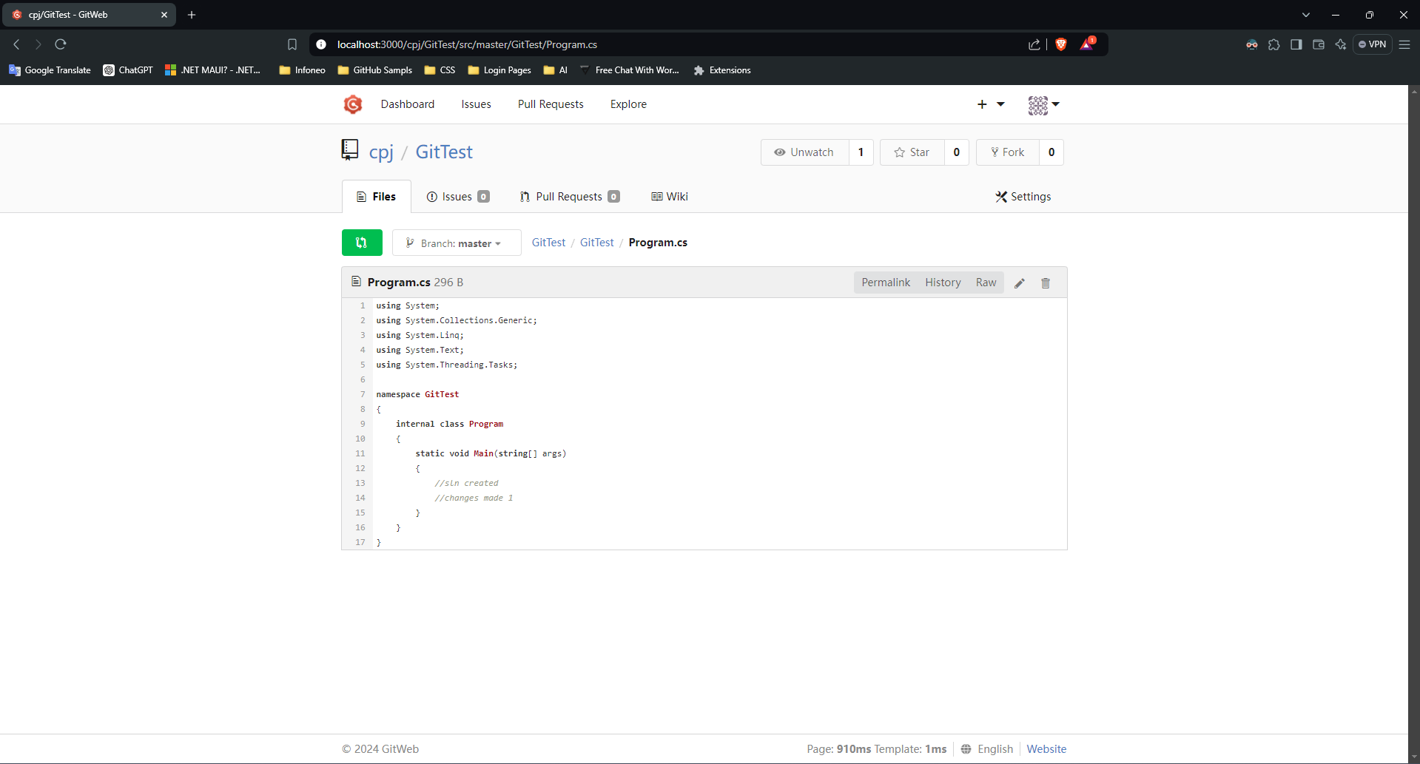

Slide 44
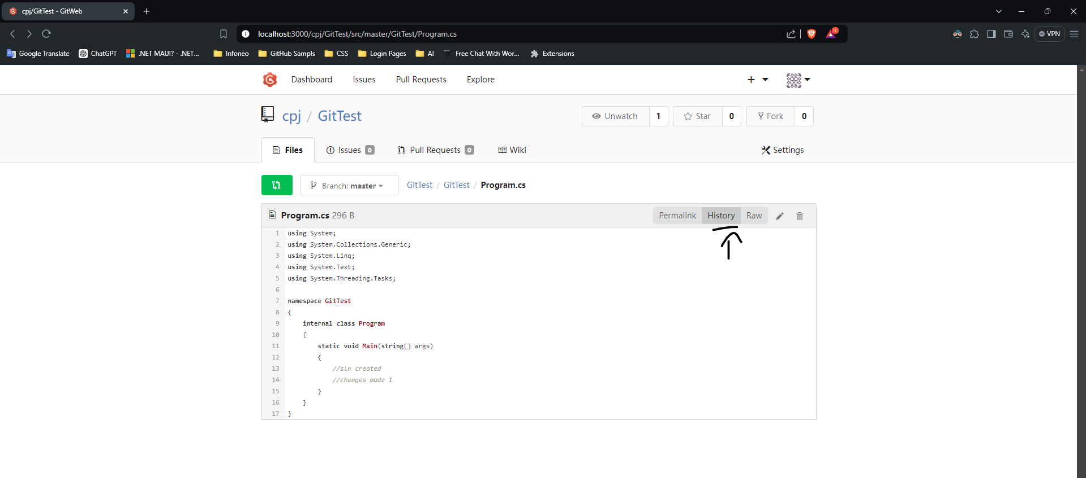

Slide 45


Slide 46

How to share added solution to other user, for this we need above all steps in remote server then only we can achieve. Here I did it in client pc local machine so I will clone this other folder

Slide 47


Slide 48


Slide 49


Slide 50


Slide 51

Use sync option to get latest version like tfs

Slide 52
Add existing solution to the git gogs as a repo, only if the solution not have local git repo

Slide 53


Slide 54


Slide 55

After clicking the create repository button just copy the link

Slide 56

Open your solution

Slide 57

Choose existing remote option and paste copied link in Remote URL field and click Create and Push button. Wait for few mins after sometimes repo added just refresh the browser you will see the added solution

